Slide 1


DANIEL Fukson
09.06.2024

Slide 2

Outline
Executive Summary
Introduction
Methodology
Results
Conclusion
Appendix

Slide 3
Executive Summary
Summary of methodologies
Data for analysis was collected from the SpaceX public API and publicly available data on Wikipedia.
Data wrangling included extracting of mission outcome to serve as the dependent variable in the Machine Learning models.
SQL queries and data visualizations (static plots, interactive maps, and an interactive dashboard) were created to discover insights about the data set and answer questions.
Interactive analysis done with the help of Folium maps and Plotly Dash
Predictive analysis was pursued using Logistic Regression, SVM (Support Vector Machine), Decision Tree, and KNN (k-Nearest Neighbors) Machine Learning models.
Summary of all results
EDA results
Interactive analysis results
Predictive analysis results

Slide 4
Introduction
Project background and context:
This project was done for a company that wants to enter the space shuttle launching business and to become a successful bidder against SpaceX company.
To do it we need to analyze and predict if the Falcon 9 first stage will land successfully.
SpaceX advertises Falcon 9 rocket launches on its website with a cost of 62 million dollars; other providers cost upward of 165 million dollars each, much of the savings is because SpaceX can reuse the first stage.
Problem that we want to find answers to:
If we can determine what factors are influencing successful landing of the first stage of Falcon 9, we can understand how to build the new spaceship and and its launching infrastructure to gain success in launching the rockets. This information can be used if we want to bid against SpaceX for a rocket launch.

Slide 5

Section 1

Slide 6
Methodology
Executive Summary
Data collection methodology:
Initial data for analysis were collected through the publicly available resources:
SpaceX REST API
Information from Wikipedia presented as the List of Falcon 9 and Falcon Heavy Launches in HTML format
Perform data wrangling
In preparation to data analysis the Data was properly structured, cleaned, enriched with meaningful content, validated and stored in csv files.
Perform exploratory data analysis (EDA) using visualization and SQL
Perform interactive visual analytics using Folium and Plotly Dash
Perform predictive analysis using classification models
Logistic Regression, Support Vector Machine, K-Nearest Neighbors and Decision Trees models have been built and evaluated for the best predicted classifier

Slide 7
Data Collection
The data sets were collected from the following sources:
Publicly accessible SpaceX API with historical launch data in JSON format
GET request to the SpaceX API to retrieve all available data in JSON format
Cleansing of the data, selecting and appending relevant features for future analysis
Converting to DataFrrame and filtering on Falcon 9 launches only, filling in missing values
Exporting to csv file
Wikipedia web page with SpaceX launch data in HTML tables from static URL
Web scraping Falcon 9 Launch Wiki page from specified URL
Use HTLML parser to create a BeautifulSoup object
Parsing the launch HTML tables into dictionary and convert it into the DataFrame
Exporting to csv file

Slide 8
Data Collection – SpaceX API
Flowchart of SpaceX API Calls
Cleansing and appending of the data through defined functions
Filling in the Dictionary with the data and convert it to DataFrame
Request data through GET call to API
Decode respose content as JSON
Filling in the missing PayloadMass with mean value for all payloads
Exclude all launches except those with the Falcon 9 booster
Export DataFrame to .csv
GitHub URL of the completed SpaceX API calls notebook
Notes:
Present your data collection with SpaceX REST calls using key phrases and flowcharts
Add the GitHub URL of the completed SpaceX API calls notebook (must include completed code cell and outcome cell), as an external reference and peer-review purpose

Slide 9
Data Collection - Scraping
Flowchart of web scraping:
Web Scrape/request the data from the Wiki page to get the text in HTML format through HTTP GET
Create a BeautifulSoup object from the Response text content
Find the right Table with the Data on Falcon 9 Launches
Extract the Columns Names from the HTML table header
Create an empty dictionary with extracted Columns Names and append it with the data parsed from the Table
Export DataFrame to .csv
Convert the Dictionary to the DataFrame
GitHub URL of the completed SpaceX Webscrapping notebook
Notes:
Present your data collection with SpaceX REST calls using key phrases and flowcharts
Add the GitHub URL of the completed SpaceX API calls notebook (must include completed code cell and outcome cell), as an external reference and peer-review purpose

Slide 10
Data Wrangling
Flowchart of Data Wrangling:
Loading the data from csv file we saved earlier (Load SpaceX dataset to the DataFrame
Calculate the number of launches per each launch site
Calculate the number and occurrence of each orbit
Calculate the number of mission outcome of the orbits
Create a landing outcome label based on outcomes of the launches and fill it with 0 for bad outcomes and 1 with good ones
Export DataFrame to .csv
Calculate the success rate of all launches
GitHub URL of the completed Data Wrangling notebook
Describe how data were processed
You need to present your data wrangling process using key phrases and flowcharts
Add the GitHub URL of your completed data wrangling related notebooks, as an external reference and peer-review purpose

Slide 11
EDA with Data Visualization
The following charts were created to look at Launch Site trends
Scatterplot to see Mission Outcome relationship split by Launch Site and Flight Number.
Scatterplot to see Mission Outcome relationship split by Launch Site and Payload.
The following charts were created to look at Orbit Type trends
Bar chart to see Mission Outcome relationship against Orbit Type.
Scatterplot to see Mission Outcome relationship split by Orbit Type and Flight Number.
Scatterplot to see Mission Outcome relationship split by Orbit Type and Payload.
The following chart was created to look at trends based on time
Line plot to see Success Rate trend by Year.
GitHub URL of the completed EDA Data Visualization notebook

Slide 12
EDA with SQL
SQL Queries were performed against the SpaceX Launch data to find out the following information:
The names of the unique launch sites in the space mission
5 records where launch sites begin with the string 'CCA’
The total payload mass carried by boosters launched by NASA (CRS)
Display average payload mass carried by booster version F9 v1.1
List the date when the first successful landing outcome in ground pad was achieved
List the names of the boosters which have success in drone ship and have payload mass greater than 4000 but less than 6000
List the total number of successful and failure mission outcomes
List the names of the Booster Versions which have carried the maximum payload mass
List the records which will display the month names, failure landing outcomes in drone ship, booster versions, launch site for the months in year 2015
Rank the count of landing outcomes (such as Failure (drone ship) or Success (ground pad)) between the date 2010-06-04 and 2017-03-20, in descending order
GitHub URL of the completed EDA with SQL notebook

Slide 13
Build an Interactive Map with Folium
The following map objects were created and added to a folium map:
Folium Markers and Circles to mark the Launch Sites locations
Folium Markers Cluster with Markers to mark the success/failed launches for each Launch Site on the map
Folium Lines to calculate and show the distance to the Launch Sites proximities
Distance from CCAFS LC-40 to the coastline
Distance from CCAFS LC-40 to the railroad
Distance from CCAFS LC-40 to the closest city
GitHub URL of the completed Interactive Map with Folium Notebook
NBViewer URL of the completed Interactive Map with Folium Notebook

Slide 14
Build a Dashboard with Plotly Dash
The following plots/graphs interactions have been added to the dashboard:
The dropdown list for selection of the Launch Site for the Dashboard analysis
The pie chart that displays the information based on Launch Site selection:
When all sites are selected - the distribution of successful Falcon 9 first stage landings between the sites
When one particular site is selected - the distribution of successful and failed Falcon 9 first stage landings for that site
The input slider that used for filtering of the payload mass for the scatterplot
The scatterplot displays the distribution of Falcon 9 first stage landings split by payload mass, mission outcome and by booster version category.
GitHub URL of the completed Dashboard with Plotly Dash Notebook

Slide 15
Predictive Analysis (Classification)
Flowchart of Classification modelling:
Logistic Regression/Support Vector Machine/Decisions Tree/KNN models created and trained with the best hyperparameteres
Loading of the datasets from csv file for analysis using pandas and numpy
Data transformation and splitting into training and testing sets
All Model are tested on the test set with accuracy score being calculated.
Finding the method/model that perform best based on accuracy scores of each model
Confusion Matrix is plotted for each used model
GitHub URL of the completed Predictive Analysis Notebook

Slide 16
Results
Exploratory data analysis results
Interactive analytics demo in screenshots
Predictive analysis results

Slide 17

Section 2

Slide 18
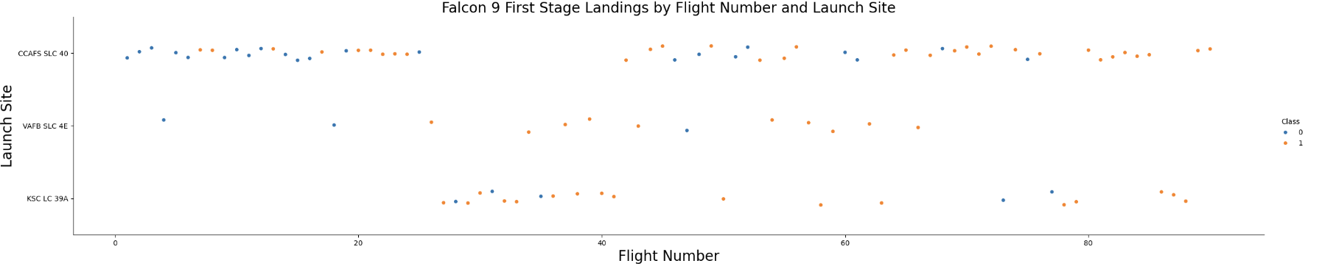
Flight Number vs. Launch Site
Blue colored dots indicates unsuccessful launch; Orange colored dots indicates successful launch
The number of launches from CCAFS SLC 40 site are significantly higher than form other sites and the number of success landings (Class = 1) are increasing with the increase of the number of launches for this site
For all site with the number of launches growing the number of successful landing (Class = 1) is also growing
Successful landing rate for sites are different with the best rate being at KSC LC39A site

Slide 19
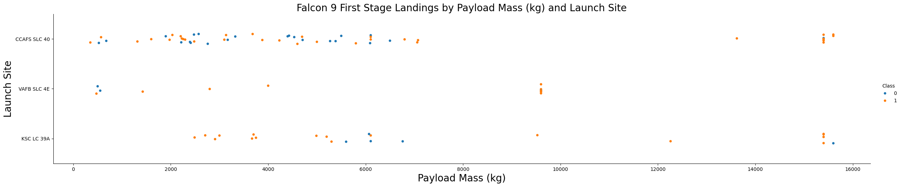
Payload vs. Launch Site
Blue colored dots indicates unsuccessful launch; Orange colored dots indicates successful launch
Most of the payloads for all sites are under 7000 kg but for those launches with the larger payloads success rate is much higher
In general, there’s no much correlation between the Payloads and successes rate of launches

Slide 20
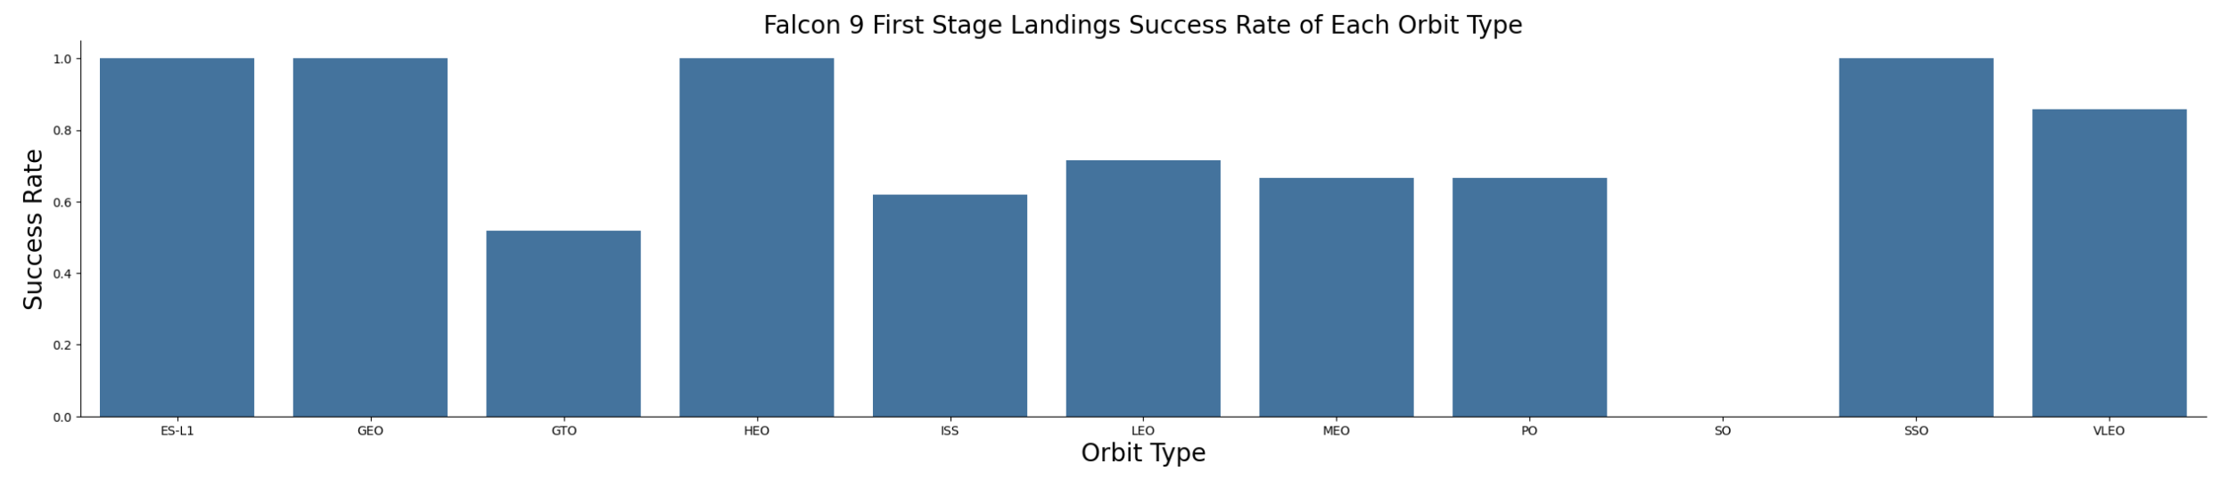
Success Rate vs. Orbit Type
ES-L1, GEO, HEO, SSO have the largest success rates. VLEO success rate is a little bit lower. GTO has the minimums success rate. Other sites are in between on these two groups.

Slide 21
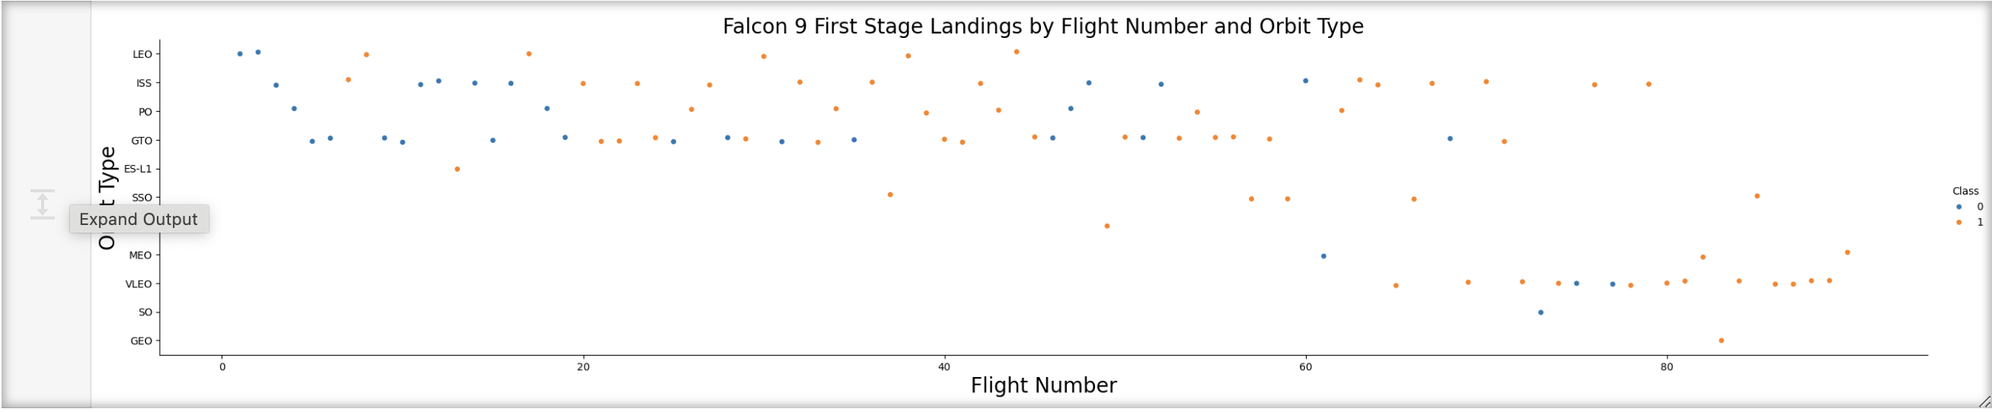
Flight Number vs. Orbit Type
Blue colored dots indicates unsuccessful launch; Orange colored dots indicates successful launch
LEO orbit success is related to the number of flights whereas in the GTO orbit, there is no relationship between flight number and the orbit.

Slide 22
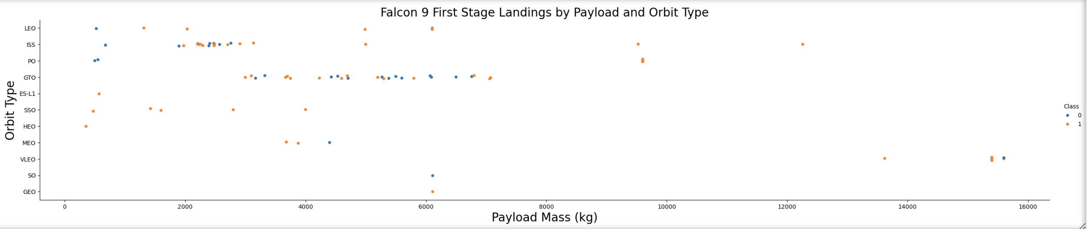
Payload vs. Orbit Type
Blue colored dots indicates unsuccessful launch; Orange colored dots indicates successful launch
We can say that with heavy payloads, the successful landing are more for PO, LEO and ISS orbits.

Slide 23
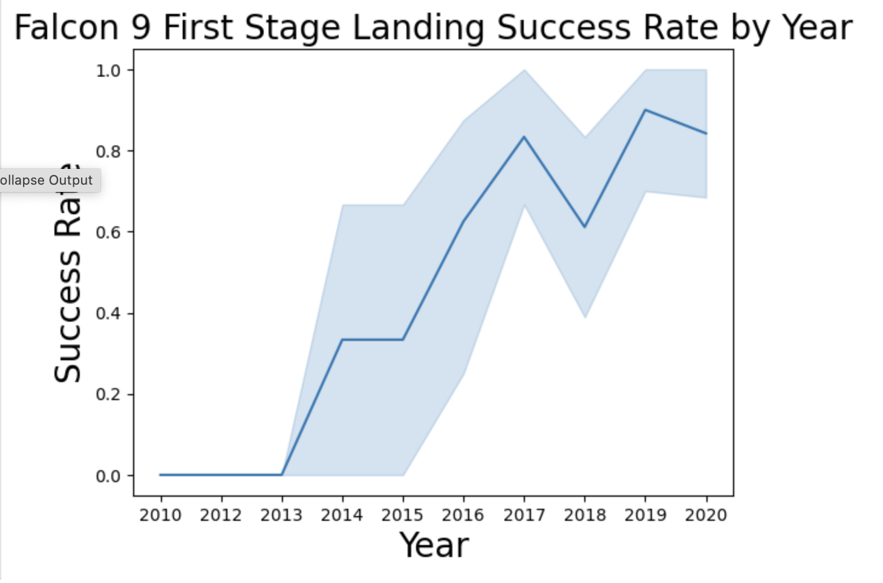
Launch Success Yearly Trend
Success Rate was increasing year over year from 2013 to 2017. 2018 it decreased, but starting from 2019 it stabilized at around 0,8.

Slide 24
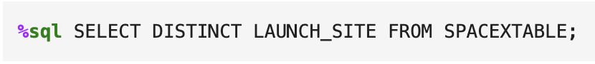
All Launch Site Names
SQL Query:
Results:
We are getting the results by querying unique values from the field Launch_Site and using SELECT DISTINCT statement
Launch_Site
CCAFS LC-40
VAFB SLC-4E
KSC LC-39A
CCAFS SLC-40

Slide 25
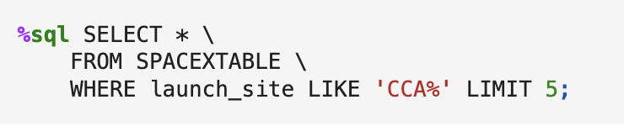
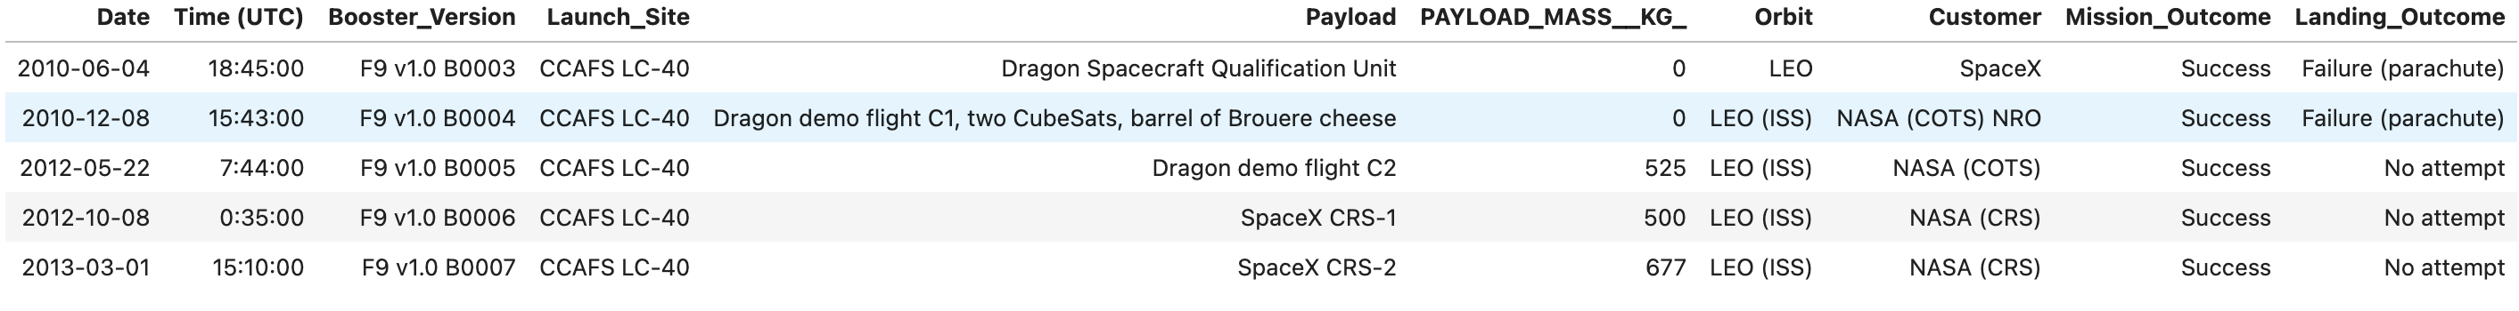
Launch Site Names Begin with 'CCA'
Find 5 records where launch sites begin with `CCA`
SQL Query
Query result:
We are getting the results by querying values from the field Launch_Site and using WHERE, LIKE for looking the “CCA” pattern and LIMIT statement to find first 5 records

Slide 26
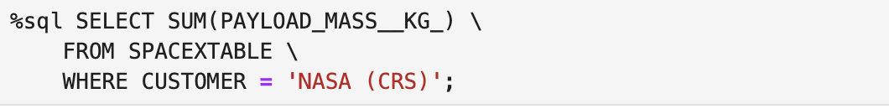
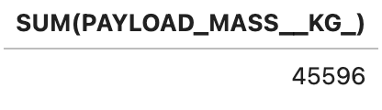
Total Payload Mass
Calculate the total payload carried by boosters from NASA
SQL Query
Query result:
We are getting the results by querying values from the fields Payload_Mass_kg and Customer and using WHERE statement to find all records where Customer is NASA and SUM statement to calculate total of payloads.

Slide 27
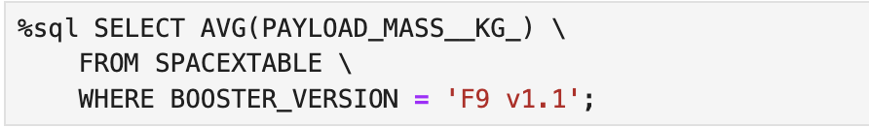
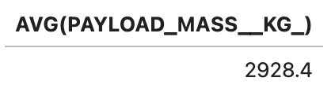
Average Payload Mass by F9 v1.1
Calculate the average payload mass carried by booster version F9 v1.1
SQL Query
Query result:
We are getting the results by querying values from the fields Payload_Mass_kg and Booster_Version and using WHERE statement to find all records where Booster is F9 v1.1 and AVG statement to calculate average of payloads.

Slide 28
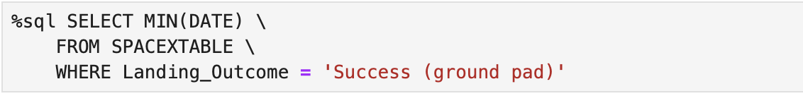

First Successful Ground Landing Date
Find the dates of the first successful landing outcome on ground pad
SQL Query
Query result:
We are getting the results by querying values from the fields Date and Landing_Outcome and using WHERE statement to find all records where landing was successful and MIN statement to present the first successful landing date.

Slide 29
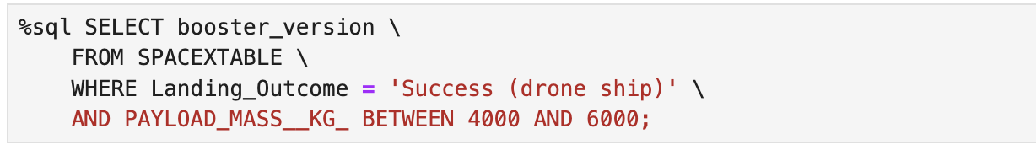
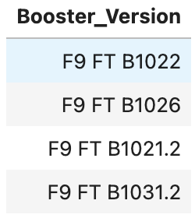
Successful Drone Ship Landing with Payload between 4000 and 6000
List the names of boosters which have successfully landed on drone ship and had payload mass greater than 4000 but less than 6000
SQL Query:
Query result:
We are getting the results by querying values from the fields Booster_version, Landing_Outcome and Payload_Mass_kg and using WHERE statement to find all records where landing was successful and BETWEEN statement to present Booster_Version with the mass between 4000 and 6000 kg.

Slide 30
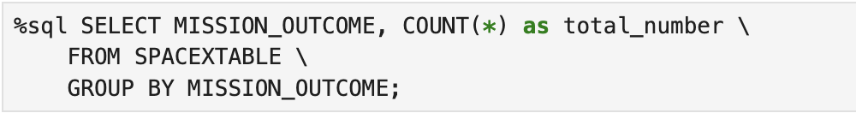
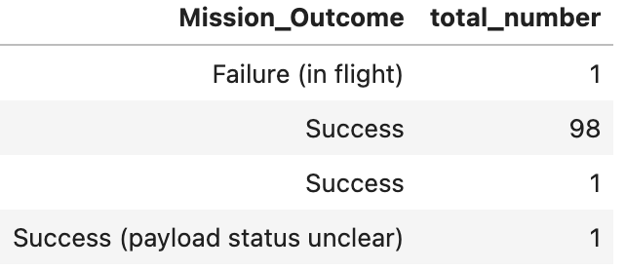
Total Number of Successful and Failure Mission Outcomes
Calculate the total number of successful and failure mission outcomes
SQL Query:
Query result:
We are getting the results by querying values from the fields Mission_Outcome and using GROUP BY and COUNT statements to find the total number of successful and failed mission outcomes.

Slide 31
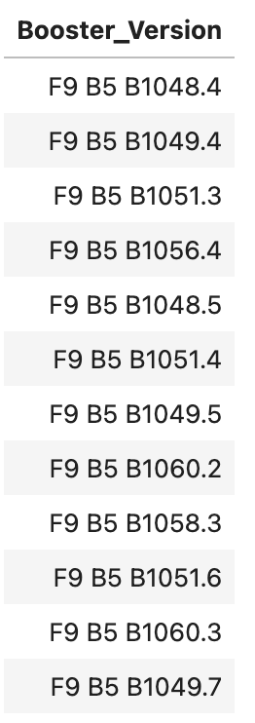
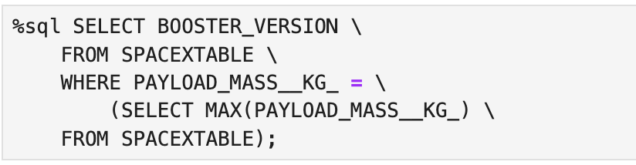
Boosters Carried Maximum Payload
List the names of the booster which have carried the maximum payload mass
SQL Query: Query result:
We are getting the results by querying values from the fields Booster_Version, Payload_Mass_kg and using subquery to select the maximum payload mass of the booster.

Slide 32

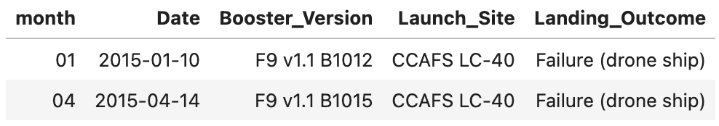
2015 Launch Records
List the failed landing_outcomes in drone ship, their booster versions, and launch site names for in year 2015
SQL Query:
Query result:
We are getting the results by querying values from the fields Date, Booster_Version, Launch_Site and Landing_Outcome and using WHERE statement to find all records where landing has failed and SUBSTR statement to find the month and the year from the Date field.

Slide 33

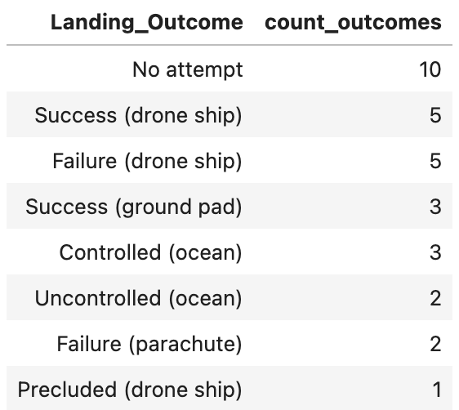
Rank Landing Outcomes Between 2010-06-04 and 2017-03-20
Rank the count of landing outcomes (such as Failure (drone ship) or Success (ground pad)) between the date 2010-06-04 and 2017-03-20, in descending order
SQL Query:
Query result: We are getting the results by querying values from the fields Landing_Outcome, Date and using COUNT, GROUP BY to calculate numbers of Outcomes grouped by Outcome result and WHERE statement to find all records with the dates from 2010-06-04 till 2017-03-20.

Slide 34

Section 3

Slide 35
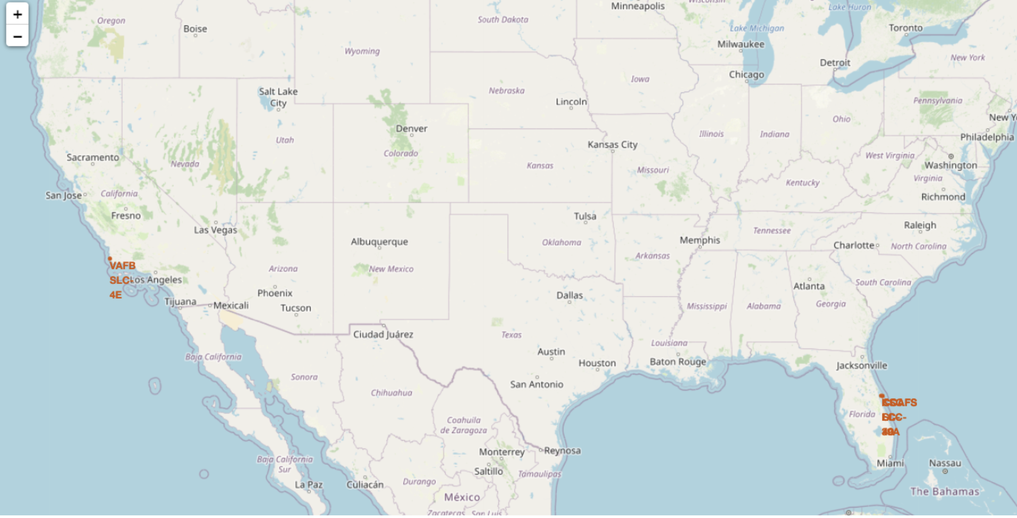
Falcon 9 Launch Site Locations
There are four Falcon 9 launch site locations. One location is in Califoria (VAFB SLC-4E) and three in Florida (KSC LC-39A, CCAFS LC-40, CCAFS SLC-40). The locations are at southern part of USA.

Slide 36
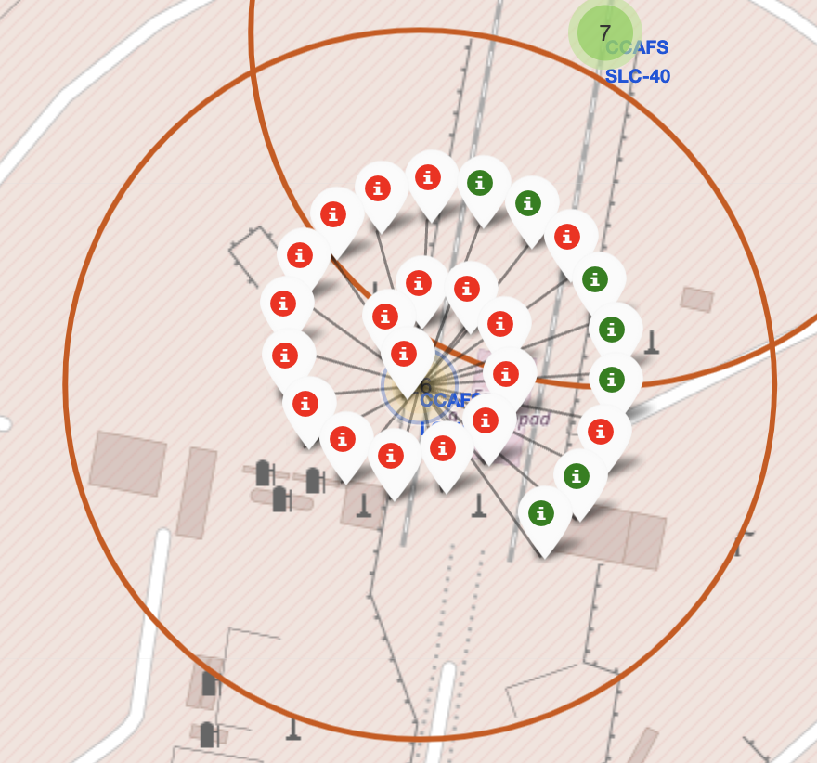
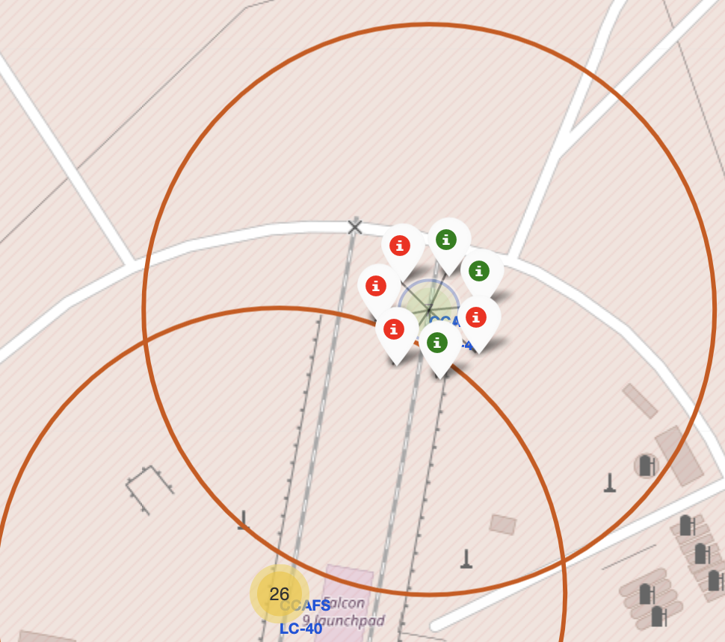
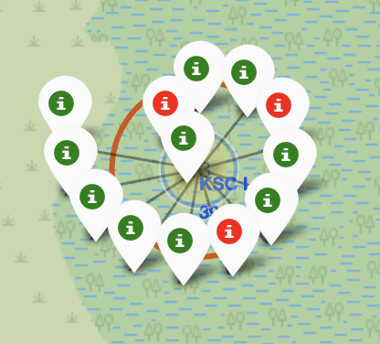
Markers of Success/Failed Landings per Launch Site
Site: CCAFS LC-40
Site: CCAFS SLC-40
Site: KSC LC-39A
The markers display the mission outcomes (Success/Failure = Red/Green) for Falcon 9 first stage landings. They are grouped on the map to be associated with the geographical coordinates for the launch site
Launch site’s success rate for Falcon 9 first stage landings can be realized from the relative number of green success markers to red failure markers.

Slide 37
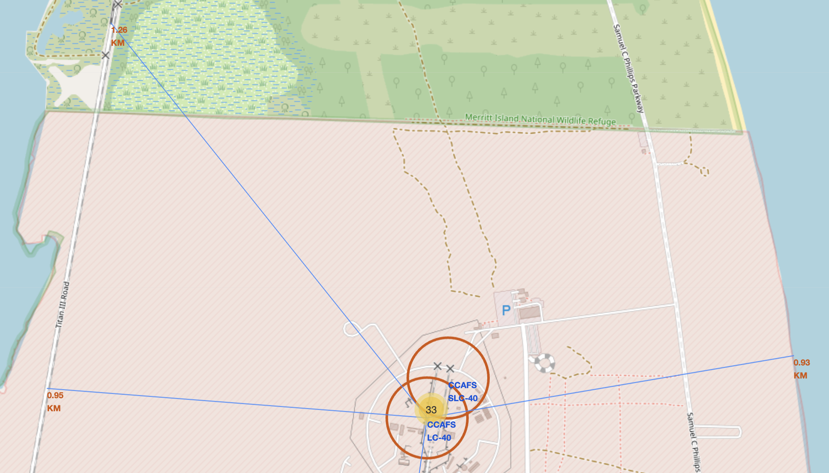
Distance from Launch Site to Proximities
Selected Launch Site is CCAFS LC-40
The coastline is 0.92 km away from CCAFS LC-40
The railway is 1,26 km away from CCAFS LC-40
The highway is 0,95 km away from CCAFS LC-40
The closest city is 19,26 km from CCAFS LC-40
The CCAFS LC-40 and CCAFS SLC-40 launch sites have coordinates that are close to each other

Slide 38

Section 4

Slide 39
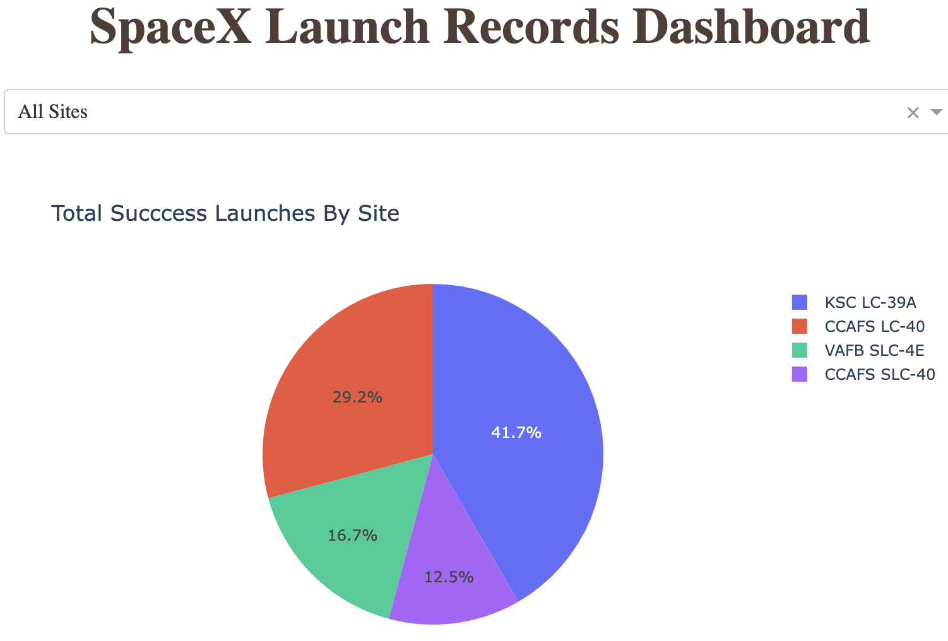
Launch Success Count for All Sites
The dropdown menu allows the selection of one or all launch sites.
With all launch sites selected, the pie chart displays the distribution of successful Falcon 9 first stage landing outcomes between the different launch sites.
The greatest share of successful Falcon 9 first stage landing outcomes (at 41.7% of the total) occurred at KSC LC-39A.

Slide 40
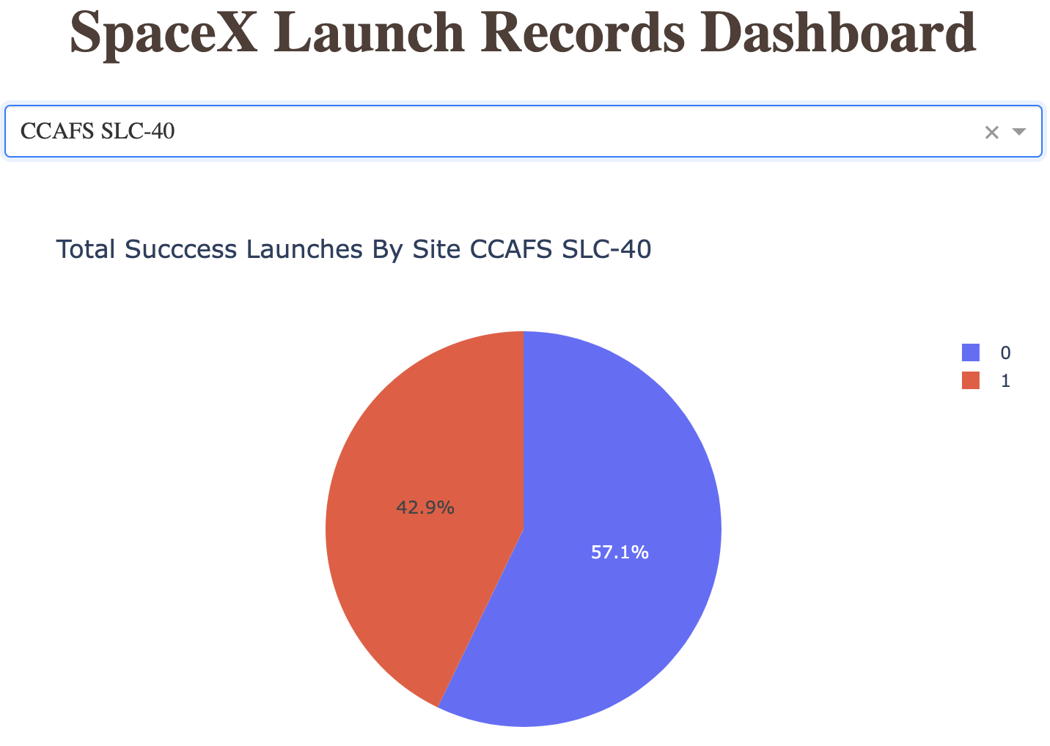
Launch Site with Highest Launch Success Ratio
Falcon 9 failed landings are indicated with the blue and successful with the red color inside the pie chart
By selecting each landing site at the dropdown menu, we can see ratio of success to failed launches
CCAFS SLC-40 was the launch site that had the highest Falcon 9 first stage landing success rate (42.9%)

Slide 41
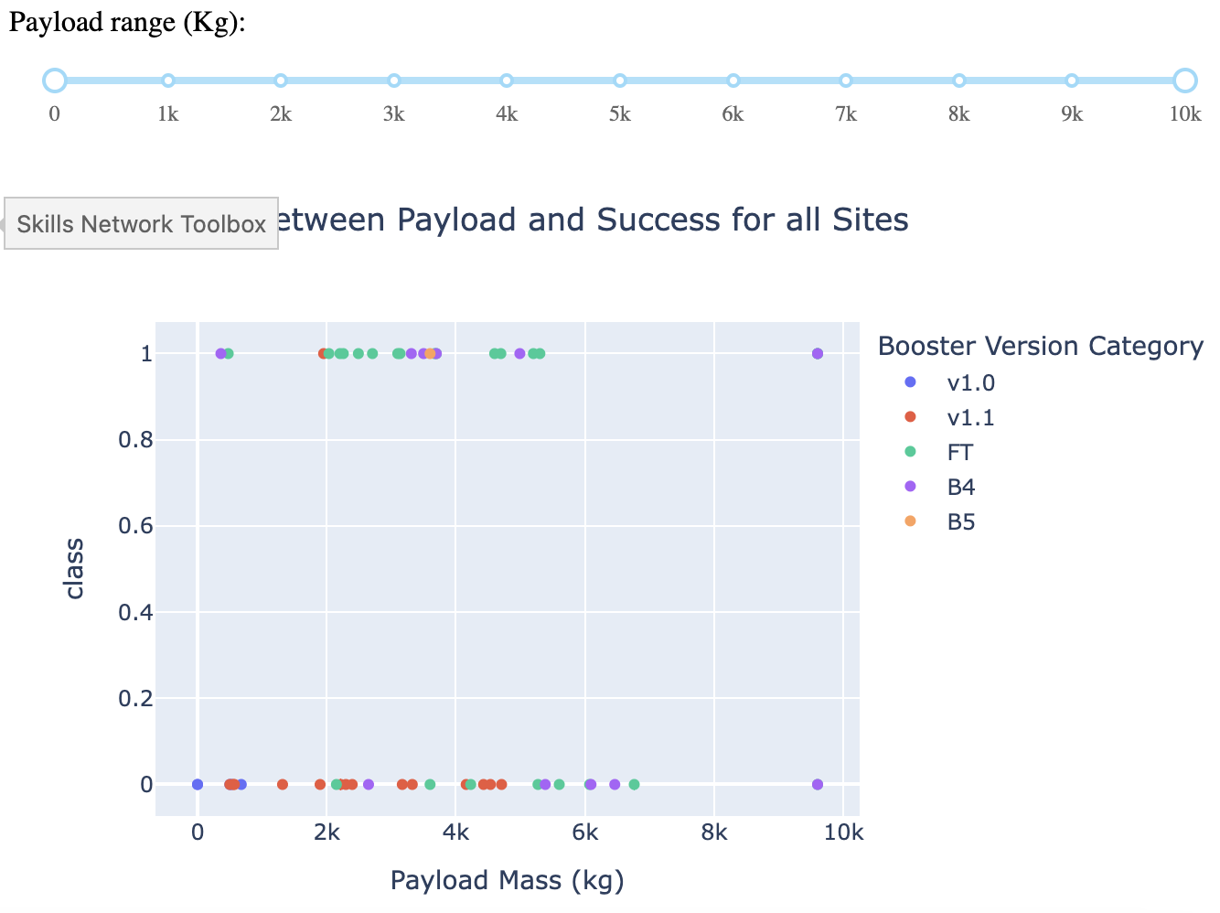
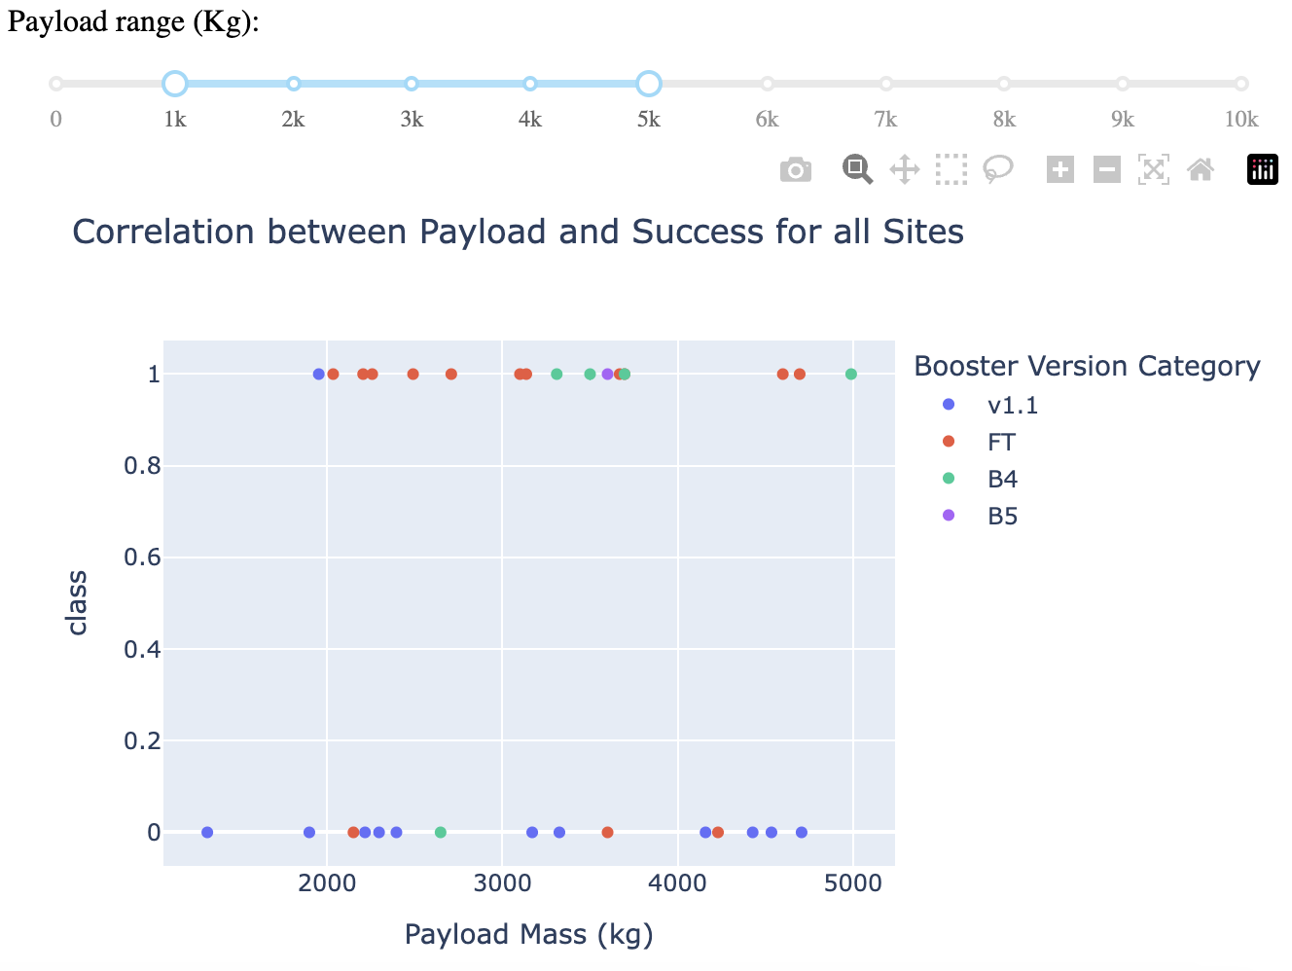
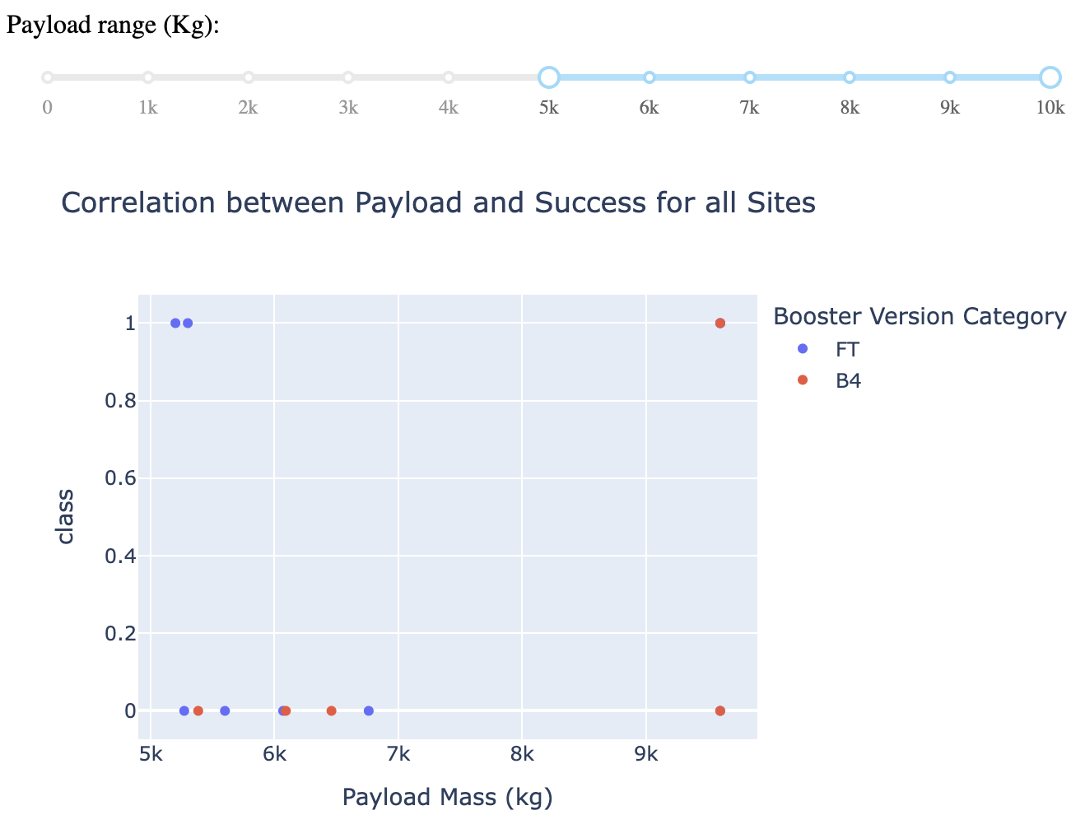
Payloads vs Launch Outcome
The payload range from about 2,000 kg to 5,000 kg has the largest success rate
The payload range from 5,000 kg to 10,000 kg has very low success rate
FT booster version has the largest success rate with low and high payloads

Slide 42

Section 5

Slide 43
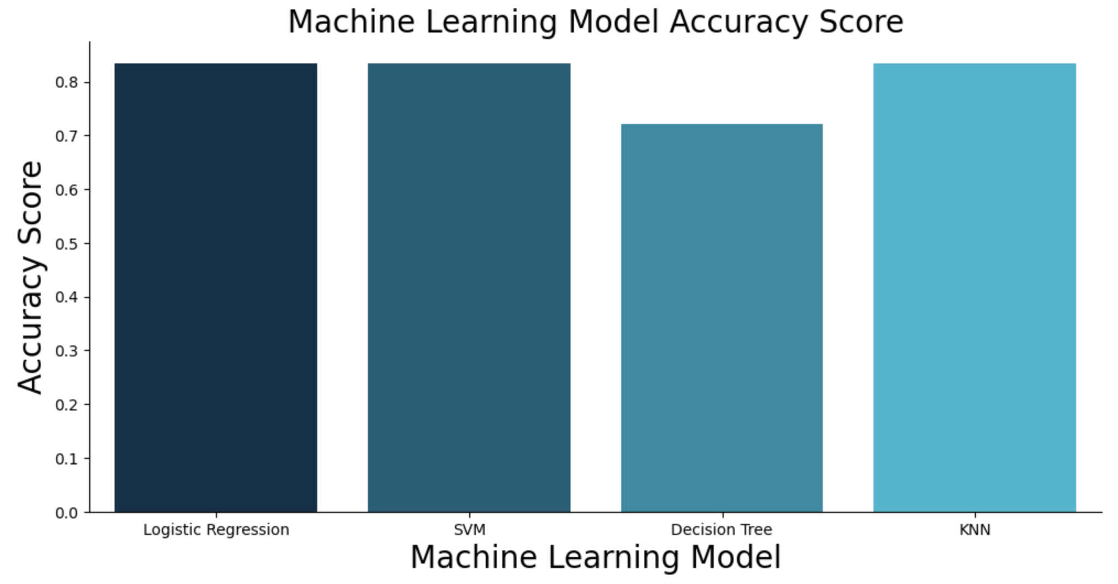
Classification Accuracy
As per bar graph built from the Classification Accuracy values Logistic Regression, SVM and KNN models show equally high classification accuracy, while Decision Tree model is lacking the accuracy for the given sets of testing and training data

Slide 44
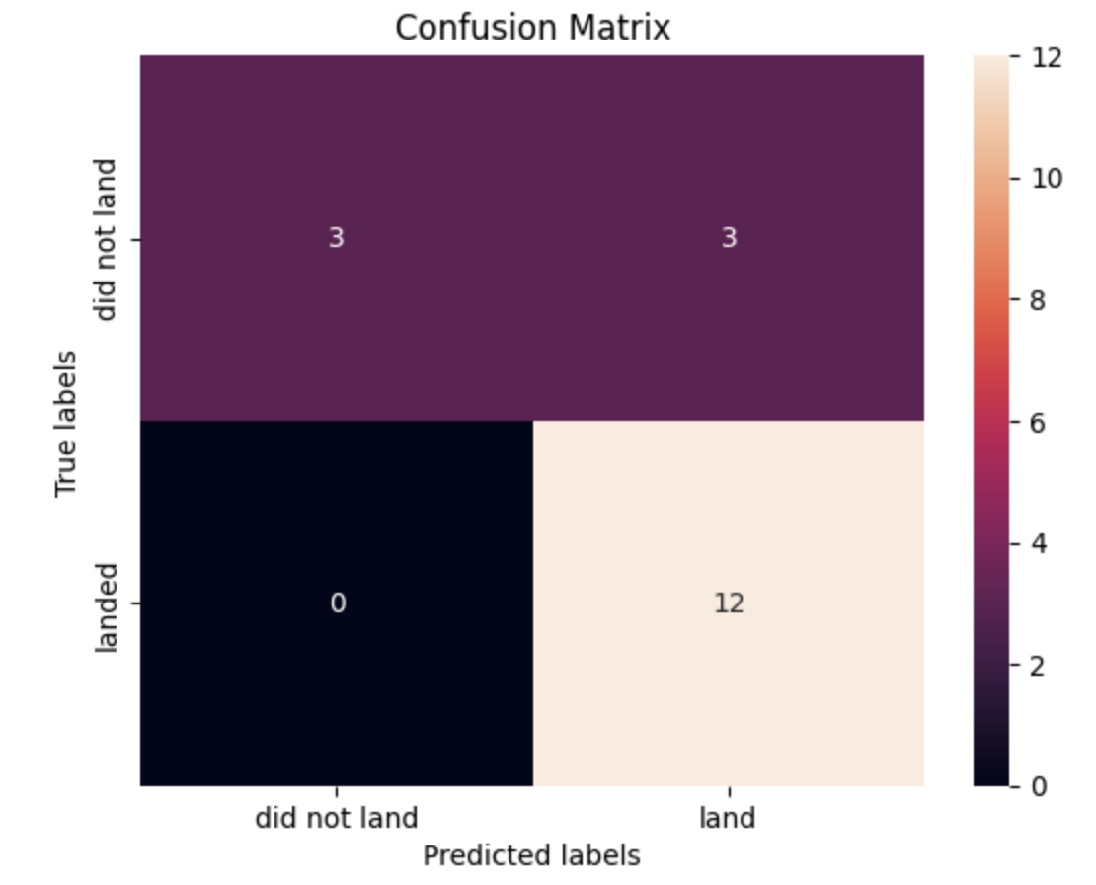
Confusion Matrix
Confusion Matrix for Logistic Regression, SVM and KNN models shows the following prediction breakdown:
12 True Positives
3 True Negatives
3 False Positives
No False Negatives
These results are better in comparison with Decision Tree model

Slide 45
Conclusions
In order to identify the factors that are influencing successful landing of the first stage of Falcon 9 we have come to the following conclusions:
SpaceX does not have a perfect track record of Falcon 9 first stage landing outcomes
SpaceX’s Falcon 9 first stage landing outcomes have been trending towards greater success as more launches are made
The best launch site is CCAFS SLC-40
Payloads, Geolocation are one of the main factors in selecting the launch site locations with successful landing output

Slide 46
Appendix
Initial Data:
SpaceX API: https://cf-courses-data.s3.us.cloud-object-storage.appdomain.cloud/IBM-DS0321EN-SkillsNetwork/datasets/API_call_spacex_api.json
Wikipedia webpage: https://en.wikipedia.org/w/index.php?title=List_of_Falcon_9_and_Falcon_Heavy_launches&oldid=1027686922
Jupyter Notebooks and Dashboard Python File
GitHub URL (Data Collection): GitHub URL of the completed SpaceX API calls notebook
GitHub URL (Web Scraping): GitHub URL of the completed SpaceX Webscrapping notebook
GitHub URL (Data Wrangling): GitHub URL of the completed Data Wrangling notebook
GitHub URL (EDA with SQL): GitHub URL of the completed EDA Data Visualization notebook
GitHub URL (EDA with Data Visualization): GitHub URL of the completed EDA with SQL notebook
GitHub URL (Folium Maps): GitHub URL of the completed Interactive Map with Folium Notebook
GitHub URL (Dashboad File): GitHub URL of the completed Dashboard with Plotly Dash Notebook
GitHub URL (Machine Learning): GitHub URL of the completed Predictive Analysis Notebook

Slide 47
Appendix
Data Sets:
https://github.com/DanielFukson/DF-spacex-ds-capstone-project/blob/main/1.1_dataset_part_1.csv
https://github.com/DanielFukson/DF-spacex-ds-capstone-project/blob/main/2.1_dataset_web_scraped.csv
https://github.com/DanielFukson/DF-spacex-ds-capstone-project/blob/main/3.1_dataset_part_2.csv
https://github.com/DanielFukson/DF-spacex-ds-capstone-project/blob/main/5.1_dataset_part__3.csv

Slide 48


